Slide 1
Extended Kalman Filter
with slides adapted from http://www.probabilistic-robotics.com

Slide 2
Kalman Filter Summary
Highly efficient: Polynomial in measurement dimensionality k and state dimensionality n: O(k^{2.376} + n²)
Optimal for linear Gaussian systems!
Most robotics systems are nonlinear!

Slide 3
Landmark Measurements
distance, bearing, and correspondence

Slide 4
Nonlinear Dynamic Systems
Most realistic robotic problems involve nonlinear functions

Slide 5
Nonlinear Dynamic Systems
localization with landmarks

Slide 6
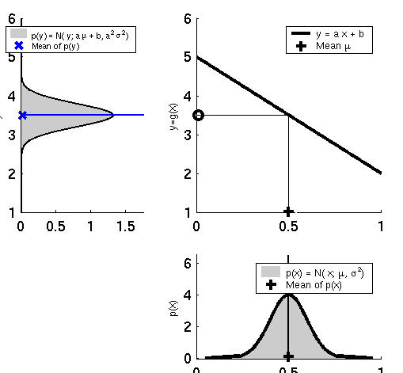
Linearity Assumption Revisited

Slide 7
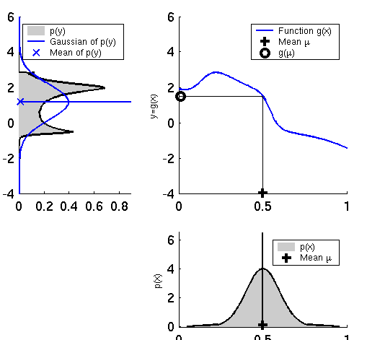
Non-linear Function

Slide 8
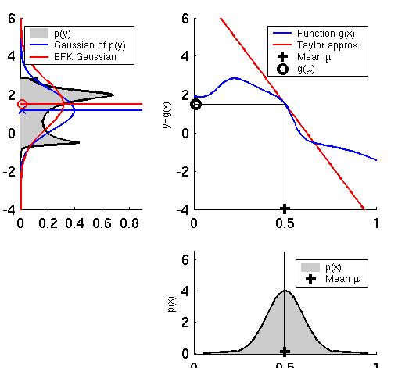
EKF Linearization (1)

Slide 9
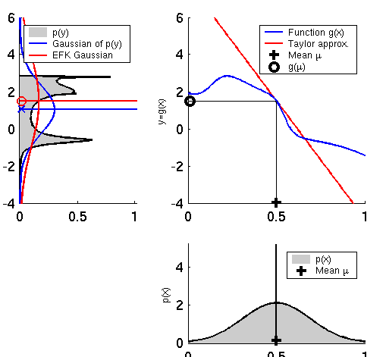
EKF Linearization (2)

Slide 10
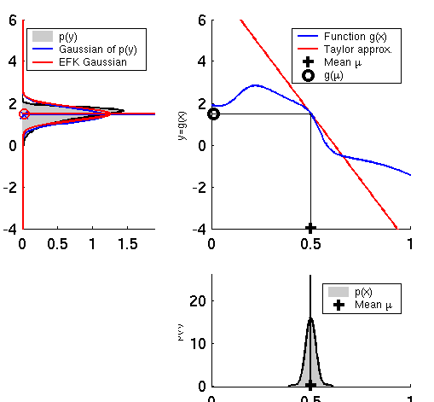
EKF Linearization (3)

Slide 11
Taylor Series
recall for f(x) infinitely differentiable around in a neighborhood a
in the multidimensional case, we need the matrix of first partial derivatives (the Jacobian matrix)

Slide 12
EKF Linearization: First Order Taylor Series Expansion
Prediction:
Correction:

Slide 13
EKF Algorithm
Extended_Kalman_filter( μ_{t-1}, Σ_{t-1}, u_{t}, z_{t}):
Prediction:
Correction:
Return μ_{t}, Σ_{t}

Slide 14
Localization
“Using sensory information to locate the robot in its environment is the most fundamental problem to providing a mobile robot with autonomous capabilities.” [Cox ’91]
Given
Map of the environment.
Sequence of sensor measurements.
Wanted
Estimate of the robot’s position.
Problem classes
Position tracking
Global localization
Kidnapped robot problem (recovery)

Slide 15
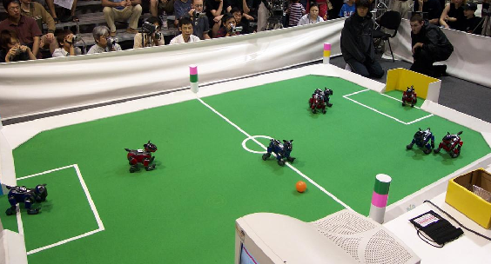
Landmark-based Localization

Slide 16
Revisit omnibot example
$$z_{t}=\left[\begin{matrix}L_{x} \\ L_{y}\end{matrix}\right]−{\left[\begin{matrix}x \\ y\end{matrix}\right]}_{t}+δ_{t}$$

Slide 17
EKF_localization ( μ_{t-1}, Σ_{t-1}, u_{t}, z_{t}, m): Prediction:
Jacobian of g w.r.t location
Jacobian of g w.r.t control
Motion noise
Predicted mean
Predicted covariance

Slide 18
EKF_localization ( μ_{t-1}, Σ_{t-1}, u_{t}, z_{t}, m): Correction:
Predicted measurement mean
Jacobian of h w.r.t location
Pred. measurement covariance
Kalman gain
Updated mean
Updated covariance

